Slide 1
Models for the Rescue

Slide 2
- S.O.L.I.D - Models for the Rescue - Domain Driven Design - DDD Introduction - DDD Strategic Design - DDD Tactical Design - Software Architecture (Parts I, II & III) - Application Lifecycle Management - Continuous Integration, Deployment, Delivery - Generic Domain as a Service - CQRS - Event Sourcing - oAuth 2.0 & OIDC - Lucene - Hystrix - Cassandra
Hello!
Notes:
Software Architecture
Boundaries,
CAP Theorem
Layered Architecture
Messaging
Microservices
Onion Architecture
Scalability
SOA
Logical Architecture vs Physical Architecture
Publish/Subscribe
Eventual Consistency

Slide 3
Agenda
Models
What is a Model?
Why do we need models?
Different model types.
Domain models.
Models in OOP
What is an Object?
Objects vs Struct
How to fight bad models
Anemic models
Heavy models

Slide 4
1.
What is a Model?
The word “model” is highly ambiguous, and there is no uniform terminology used by either scientists or philosophers.

Slide 5
Establishing UL
A systematic description of an object, theory, concept or phenomenon that shares important characteristics with the subject being researched and therefore can represent that subject in conducting simulations and calculations or in making predictions. Models can be material, visual, mathematical, empirical, computational etc.

Slide 6
Why do we need models?
Explain and observe real life objects/phenomenas , their behavior and interactions
Make predictions
Break down problems
Notes:
Let’s show some examples:

Slide 7
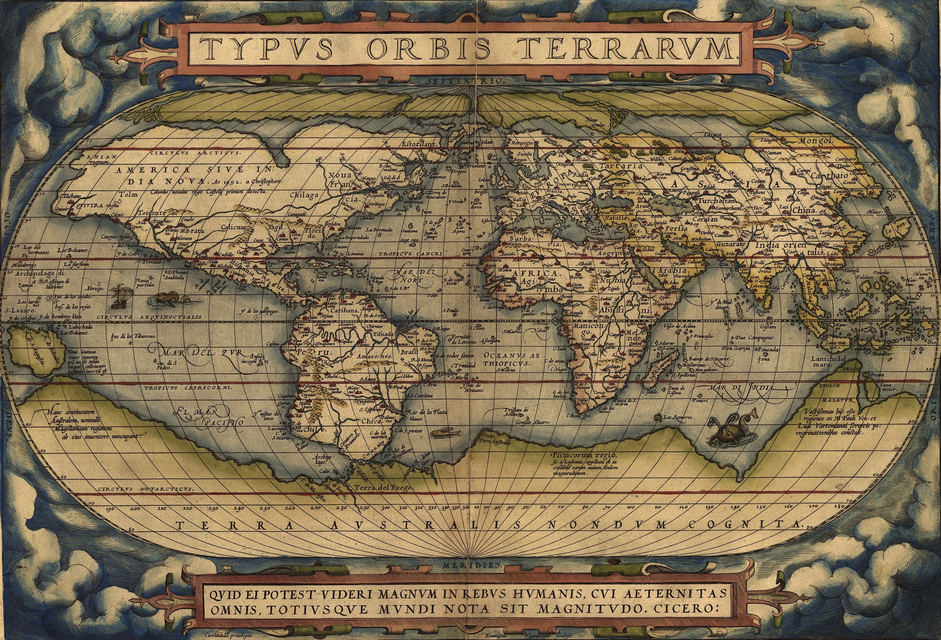

Slide 8
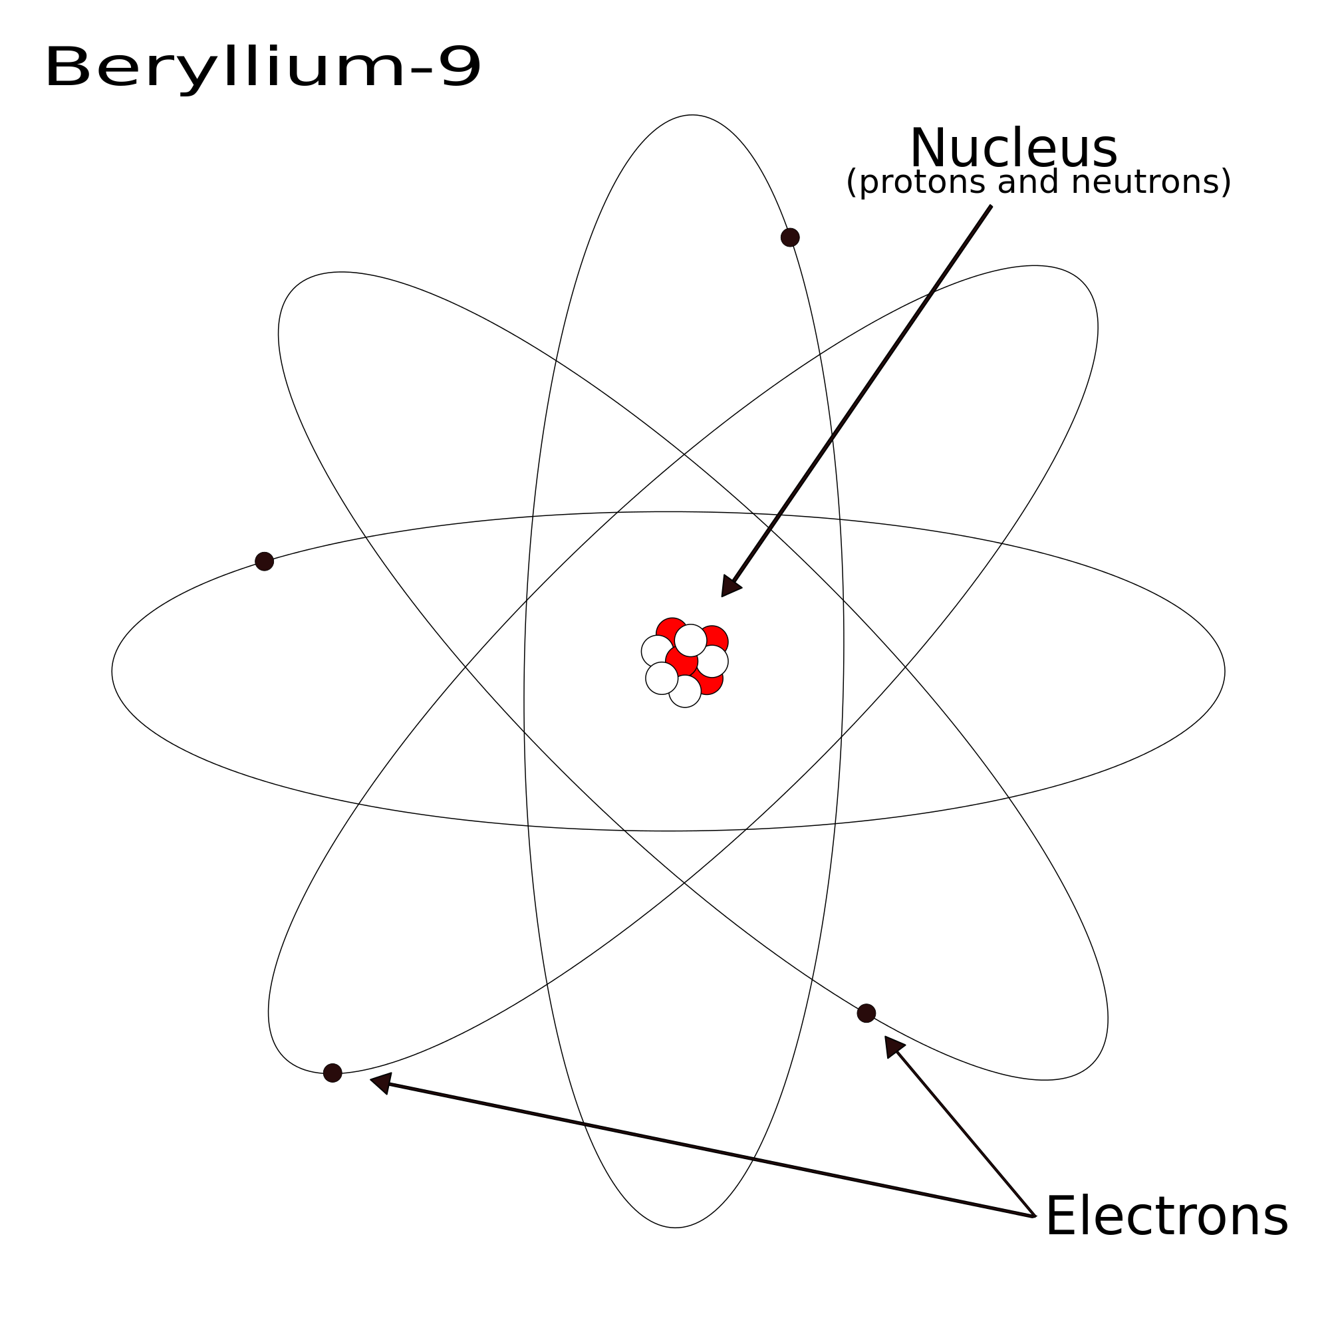

Slide 9
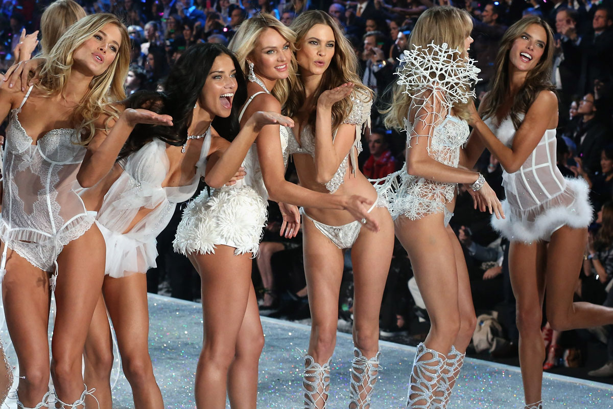

Slide 10
"Essentially, all models are wrong,
but some are useful.“
- George E .P. Box

Slide 12
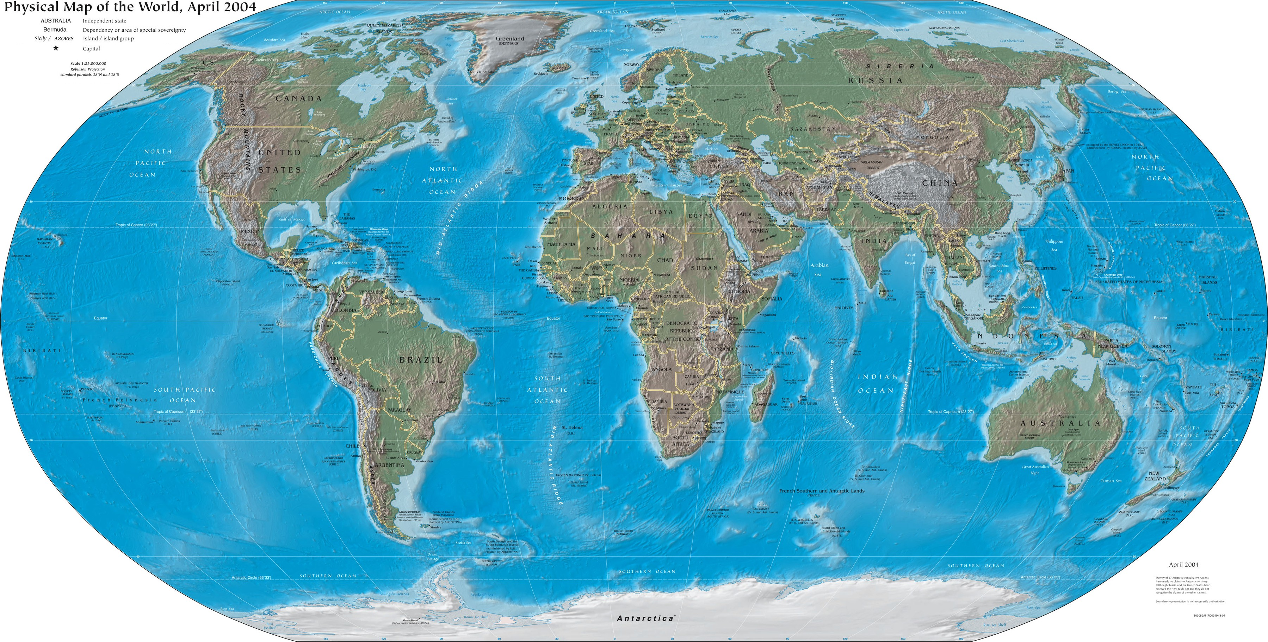

Slide 14
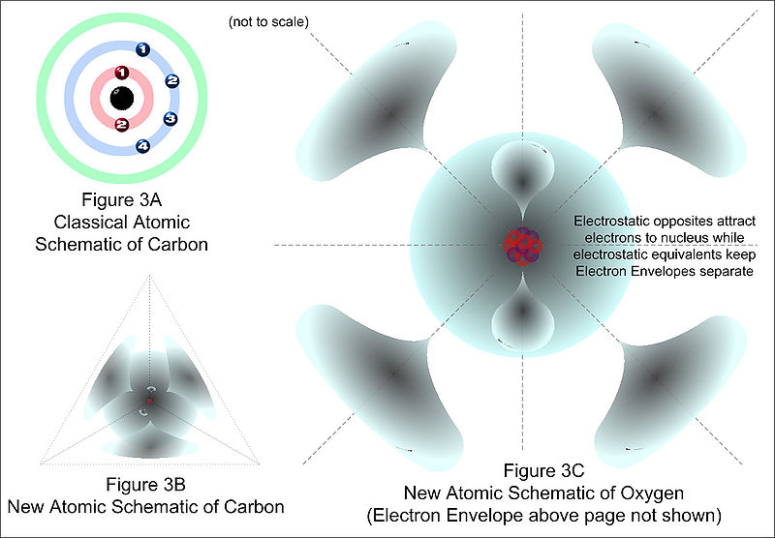

Slide 15
How does all that helps us?

Slide 16
Enterprise Software
problem
model
solution
Notes:
Usually we have a business problem. Or a problem space aka Domain.
In order to build a software solution we do software models aka business models/domain models.

Slide 17
Software
Models in OOP
Notes:
Software models in OOP are OBJECTS!
In order to show some code, lets talk in the domain of an NEXT ecommerce system.
Shopping cart example.

Slide 18
E-Commerce
We have a shopping cart, users orders etc.
Every one is familiar.

Slide 19
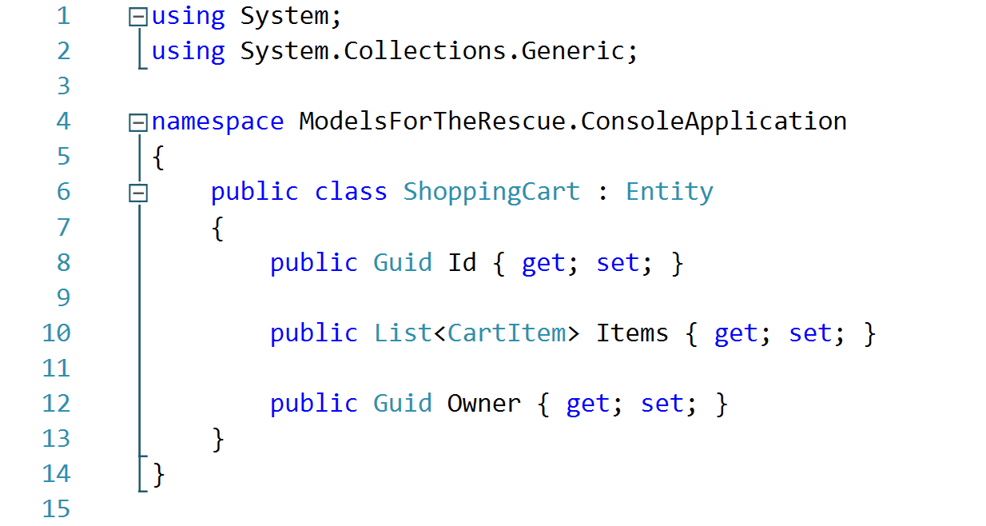
Notes:
Those models are known as Business Models, Domain Models or Entities.
OFC to work with this class there is a Cart Service.

Slide 20
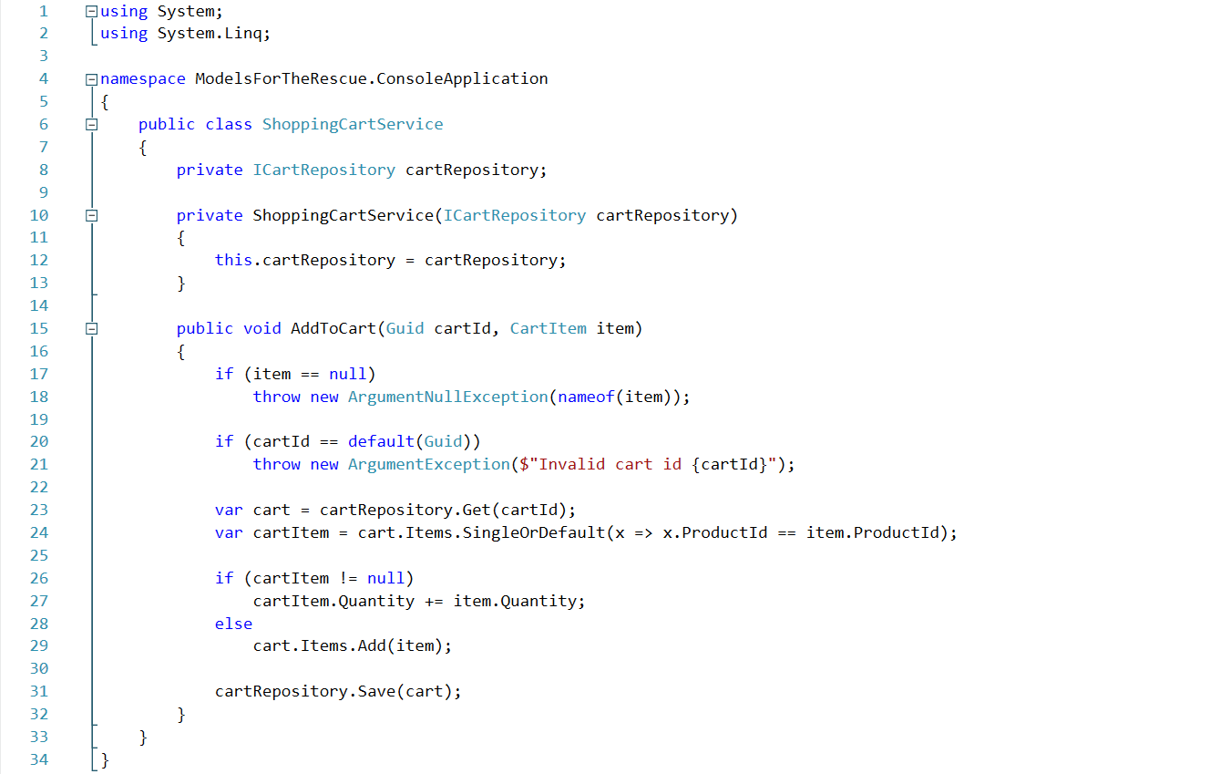
Notes:
This is a service with some BL;
But what’s the problem?

Slide 21
Notes:
This is not an object. Because by definition NEXT;

Slide 22
Object
In object-oriented programming, an object is a data structure encapsulated with a set of routines, called "methods ", which operate on the data. Operations on the data can only be performed via these methods.
Notes:
The objects have behavior.
They are incasulated.

Slide 23
Notes:
Most of the people can see a struct here but this is passed as a references so its incorrect to say that this is a struct.
This is called anemic model: Next;

Slide 24
Anemic Models
Notes:
Why anemic?

Slide 25
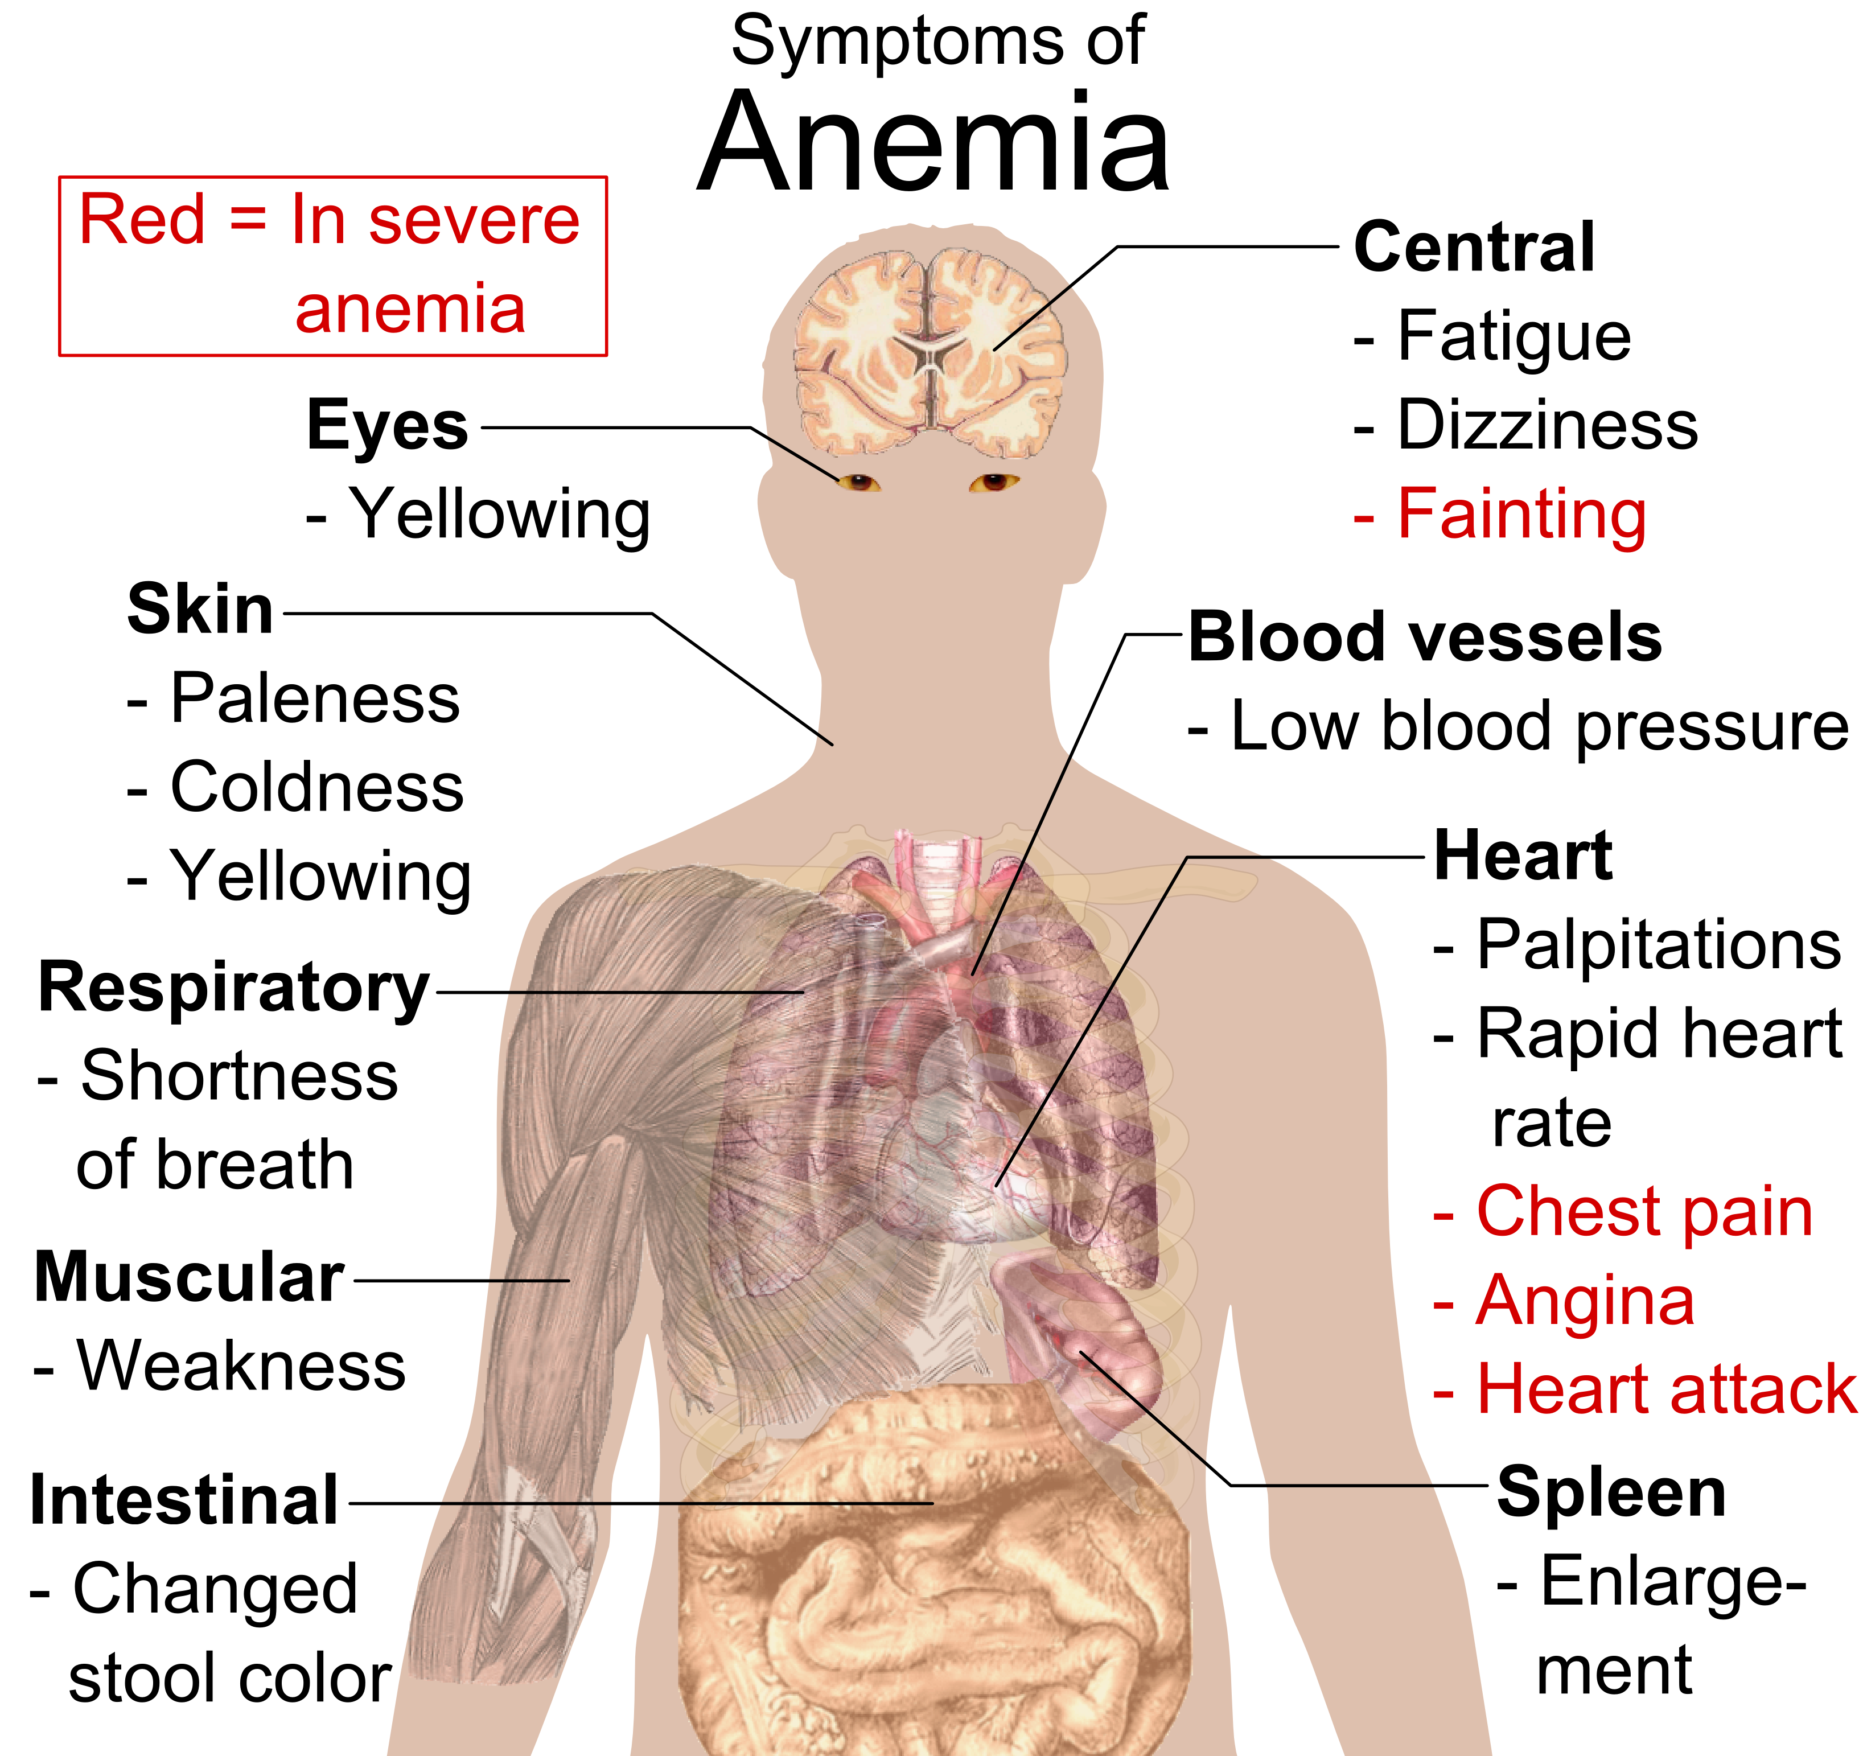
Sympthoms of anemia
Paleness
Yellow eyes
Shortness of breath
Weak muscules
Low blood pressure
Notes:
All of the above. Basically it means that it can not do anything be him self. NEXT;

Slide 26
Notes:
That’s why the anemic model needs a manager or a service to do the work for him. Talk on the code.

Slide 27
Tell don’t ask
Notes:
Why anemic?

Slide 28
Let’s Refactor

Slide 29
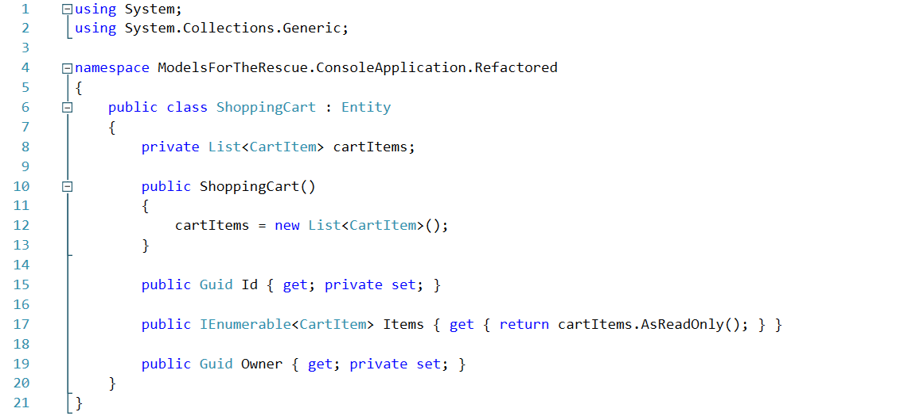
Encapsulation

Slide 30
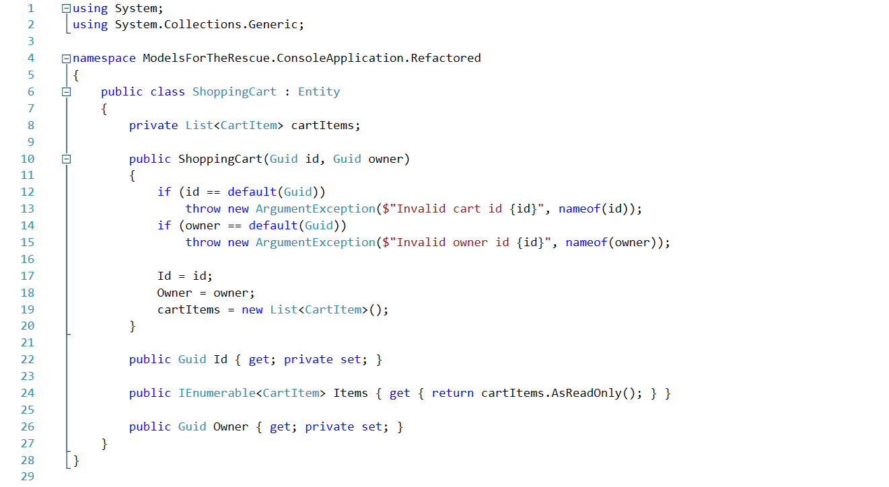
The constructor

Slide 31
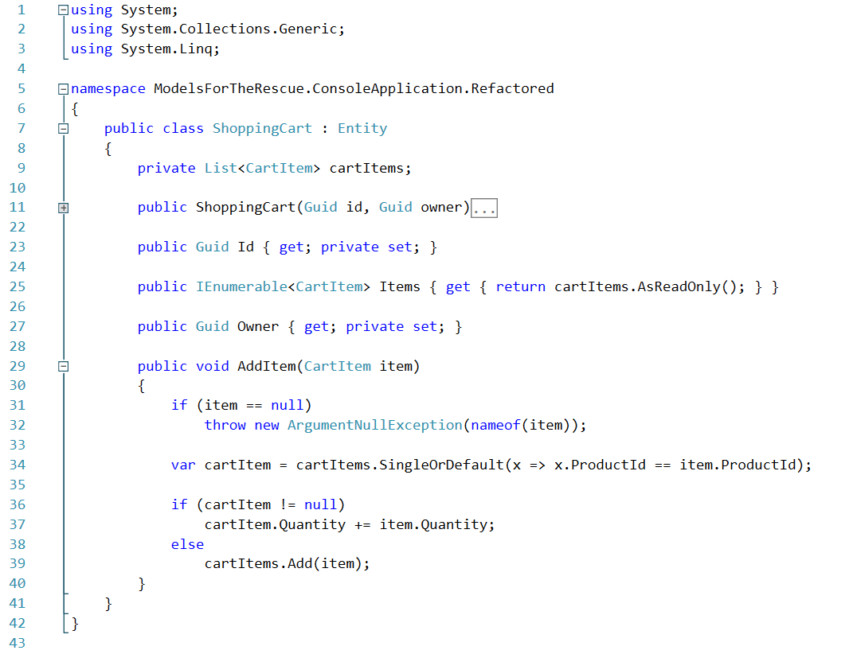
Add Behavior
Notes:
The business logic

Slide 32
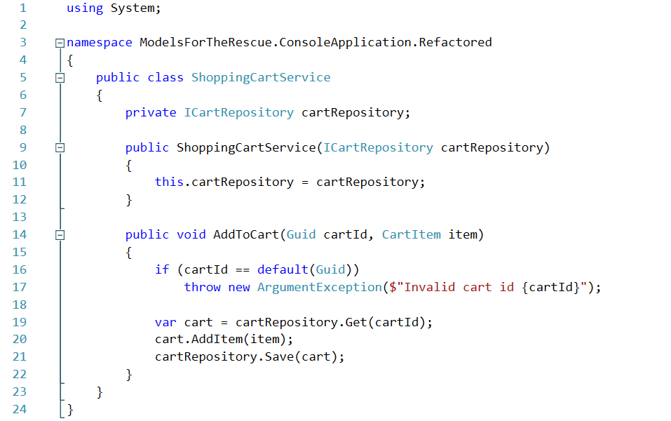
The service
Notes:
Service responsibilities:
Load the model.
Satisfy Dependencies, like connection with external systems etc.
Call the respective method.
Save the model.
For the purpose of the presentation we will show another healthy model. NEXT;

Slide 33
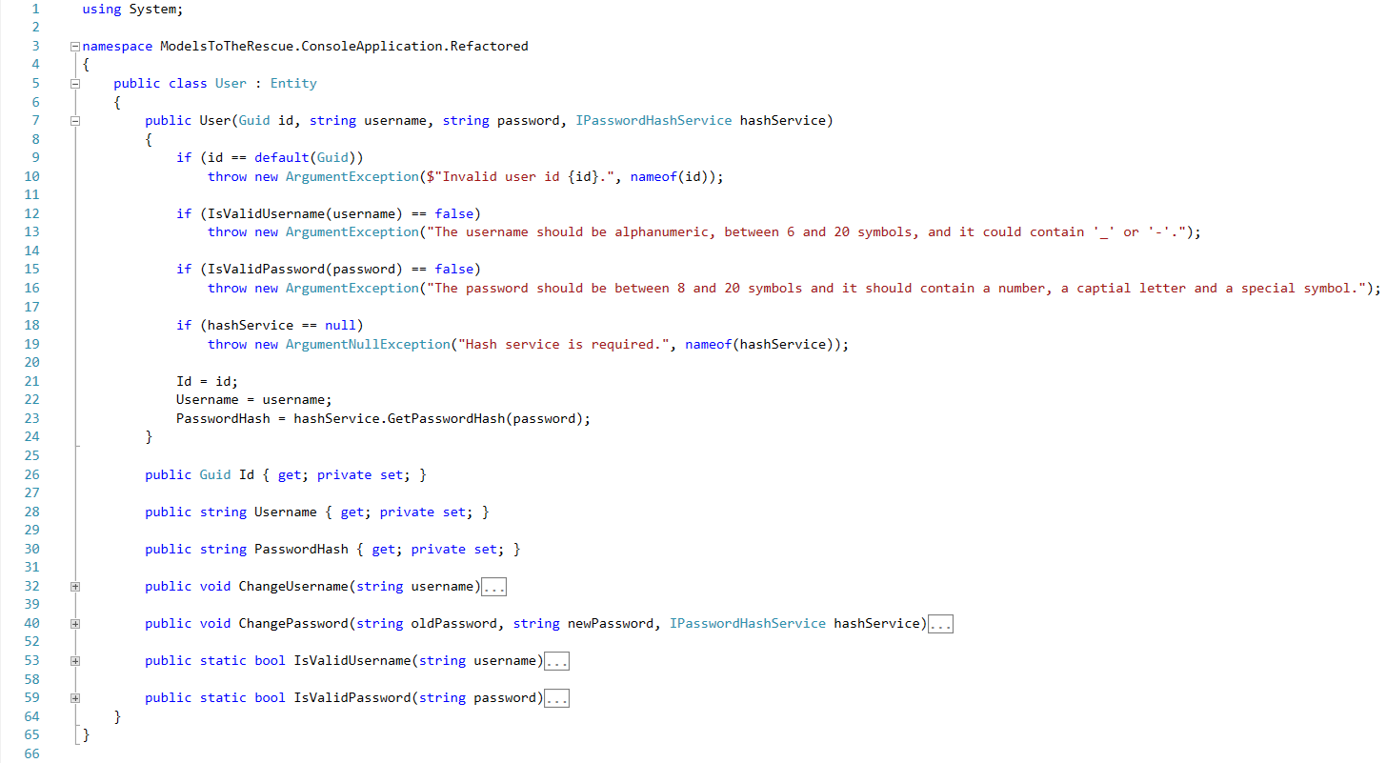
Notes:
Talk trough the constructor

Slide 34
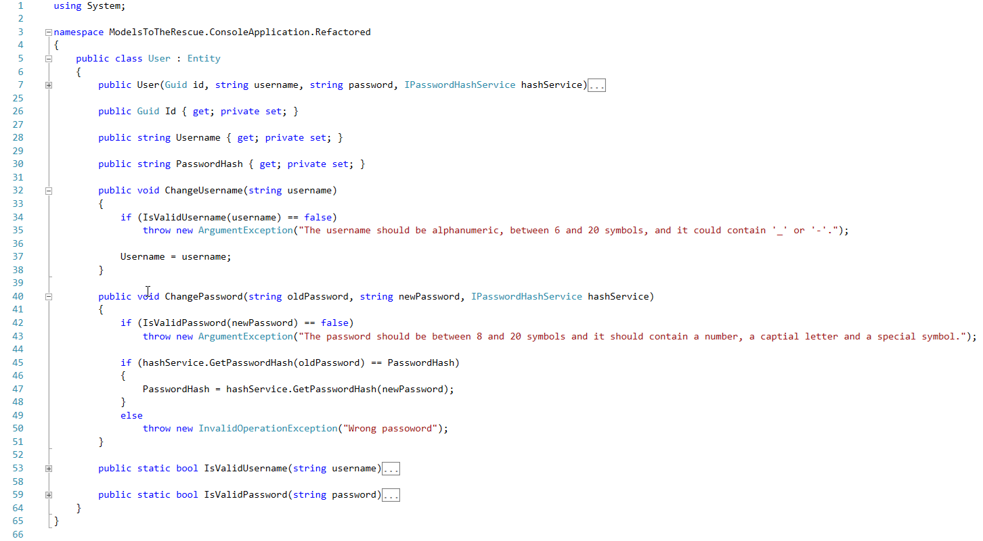
Notes:
Talk about the methods

Slide 35
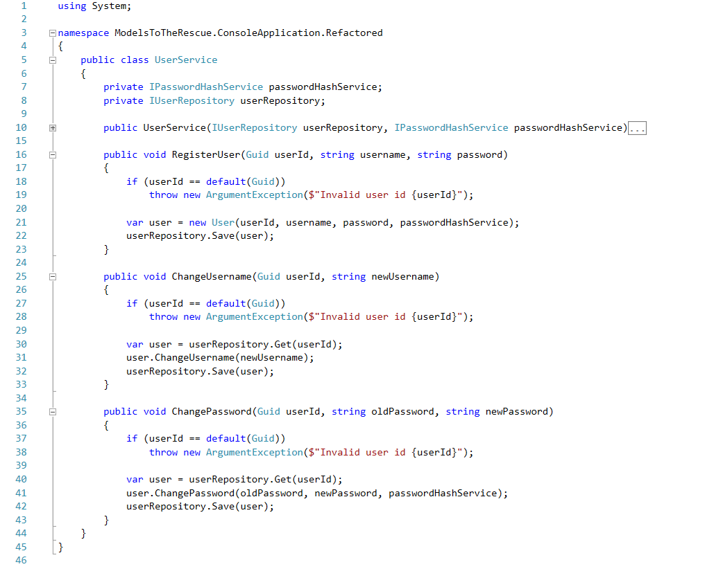
Notes:
Talk about the methods.
Generally we can improve this code even more with some tactical patterns. But about this in the following presentations

Slide 36
But why the anemic models are so frequent? We are so used to see them everywhere…

Slide 37
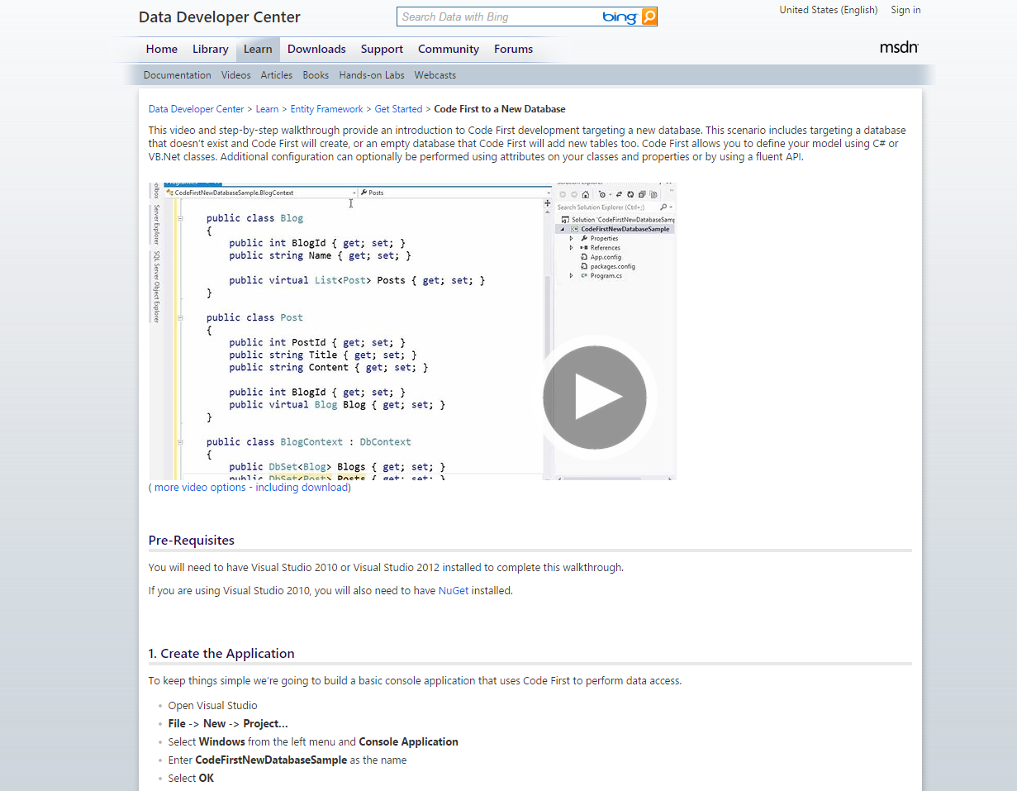
MSDN Code First
https://msdn.microsoft.com/en-us/data/jj193542.aspx
Notes:
MSDN Code first EXAMPLE for EF 4,5,6

Slide 38
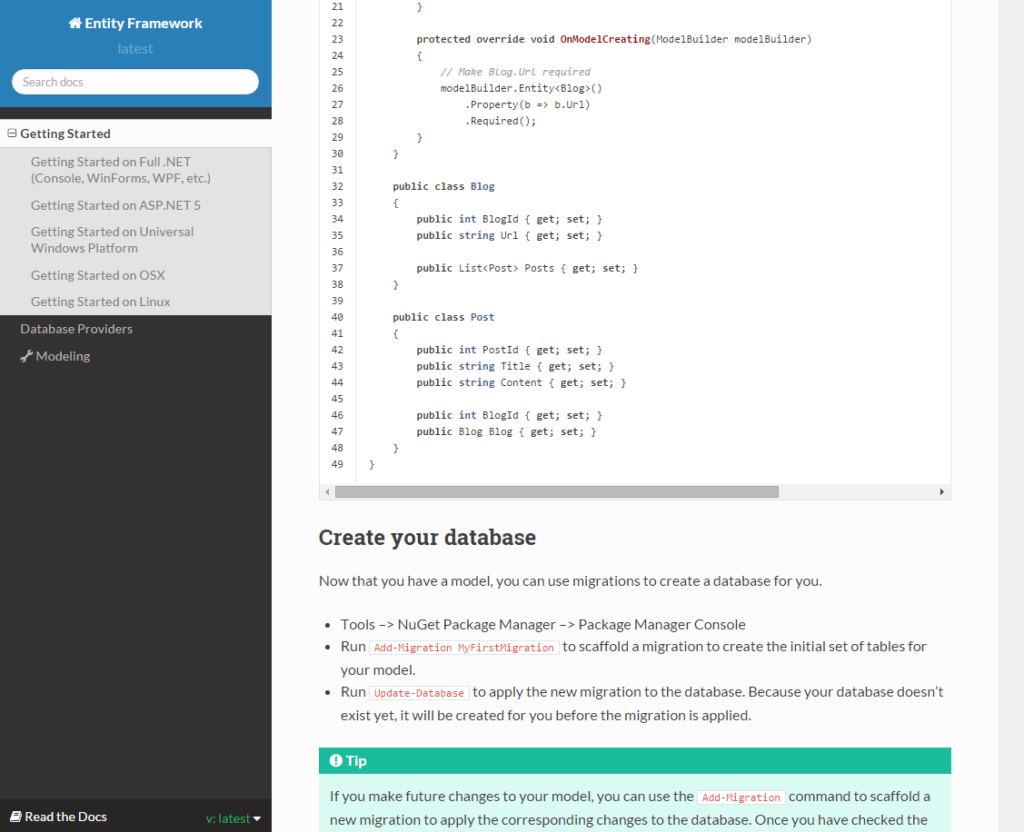
MSDN Code First EF 7 Documentation
https://msdn.microsoft.com/en-us/data/jj193542.aspx
Notes:
MSDN Code first EXAMPLE for EF 4,5,6

Slide 39
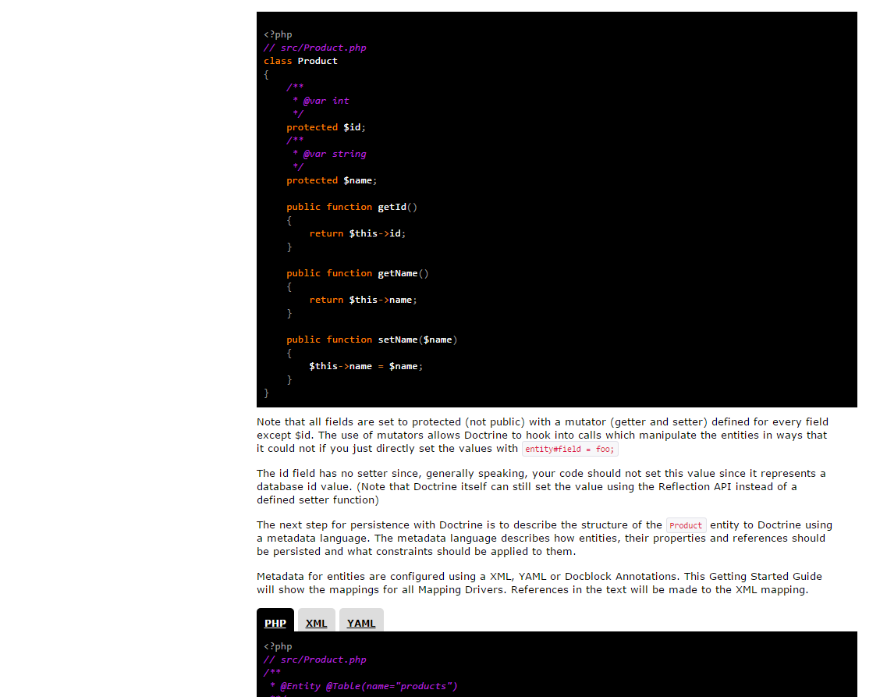
PHP Doctrine 2.4
http://doctrine-orm.readthedocs.org/projects/doctrine-orm/en/latest/tutorials/getting-started.html#what-are-entities
Notes:
This is the latest documentation as of 8th of October 2015
Latest doctrine version is 2.5

Slide 40
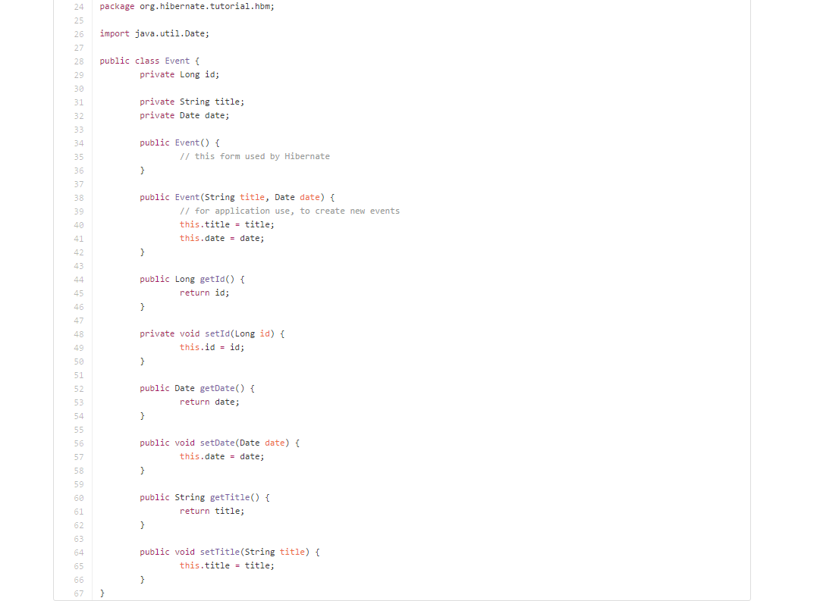
Java Hibernate 5.0
https://github.com/hibernate/hibernate-orm/blob/master/documentation/src/main/asciidoc/quickstart/tutorials/

Slide 41
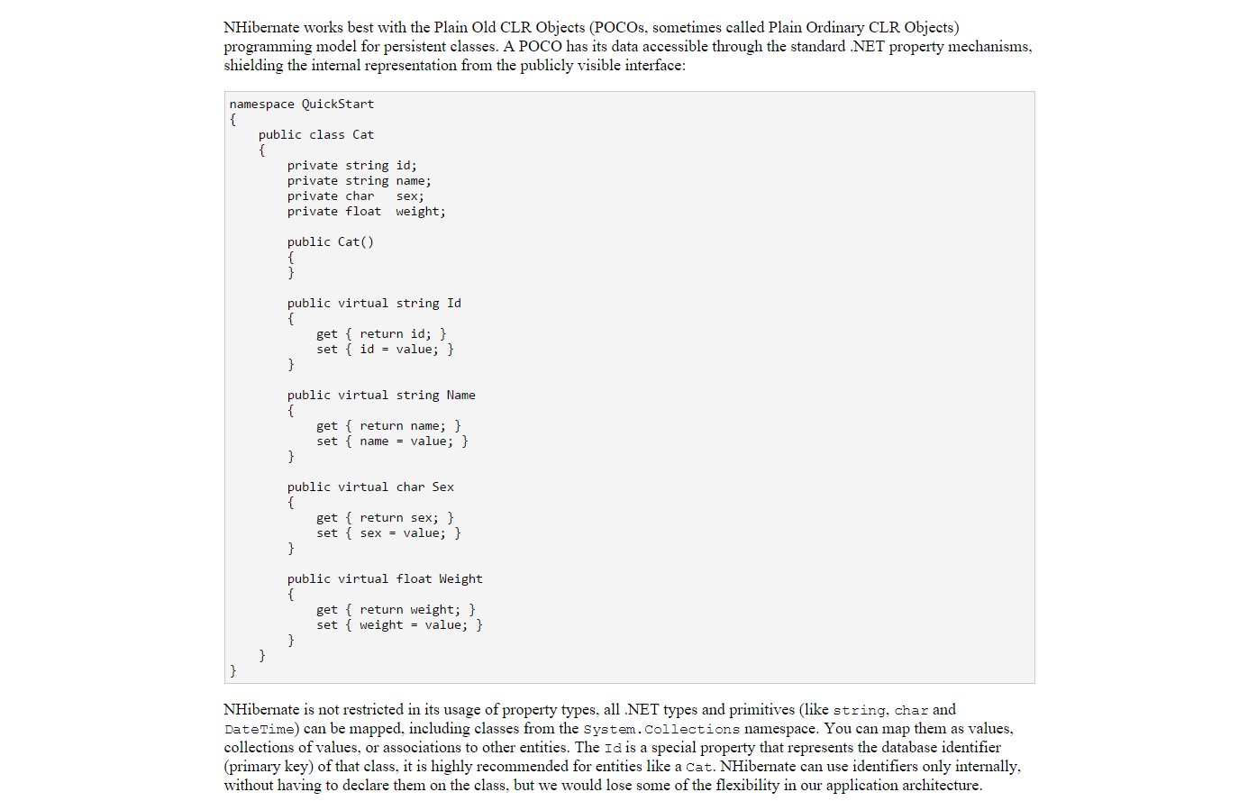
NHibernate 4.0.4
http://nhibernate.info/doc/nh/en/index.htm

Slide 42
All good…
Notes:
Our models are strong and rich. Everything is good. Phase one of the E Commerce is done, orders are placed etc. Every time an order is created a shipping address is sent. A new requirement comes that the user should have ShippingAddress

Slide 43
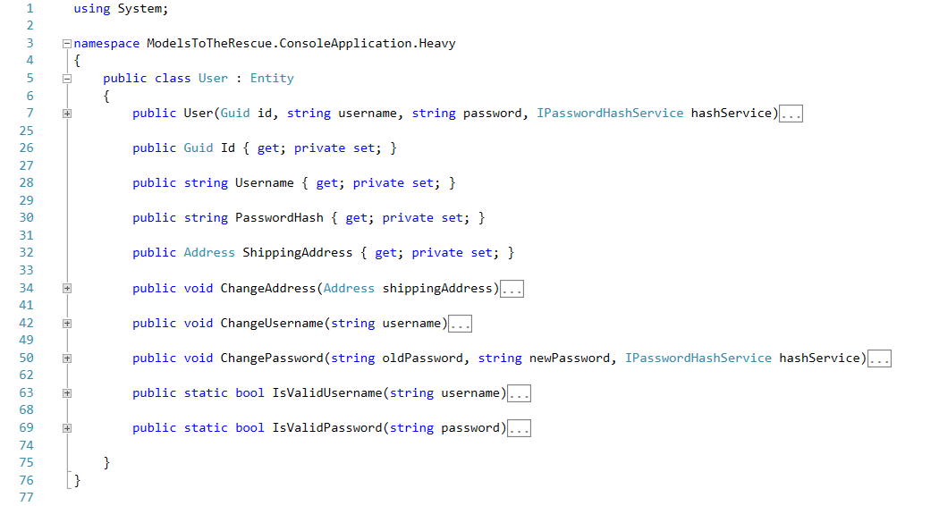
Notes:
Adding the address

Slide 44
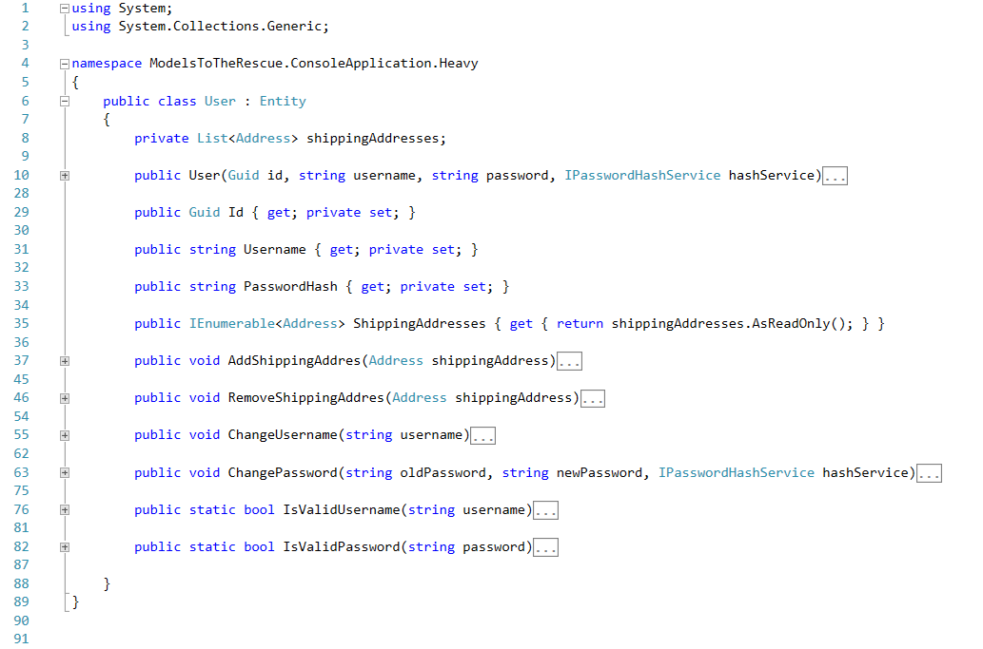
Notes:
Add multiple addresses for regular customers. And enterprise customers.

Slide 45
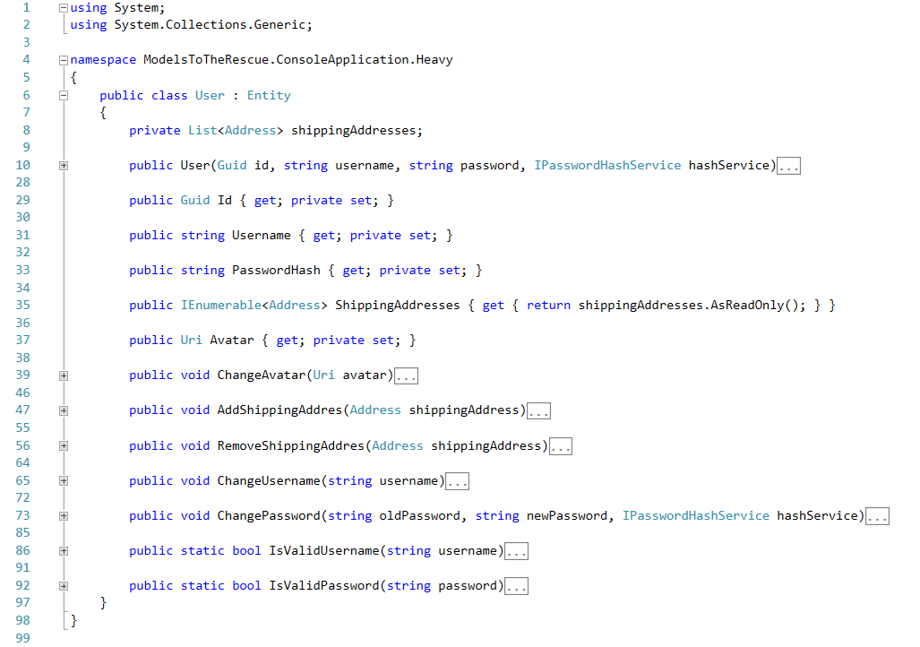
Notes:
Than we add an Avatar…..

Slide 46
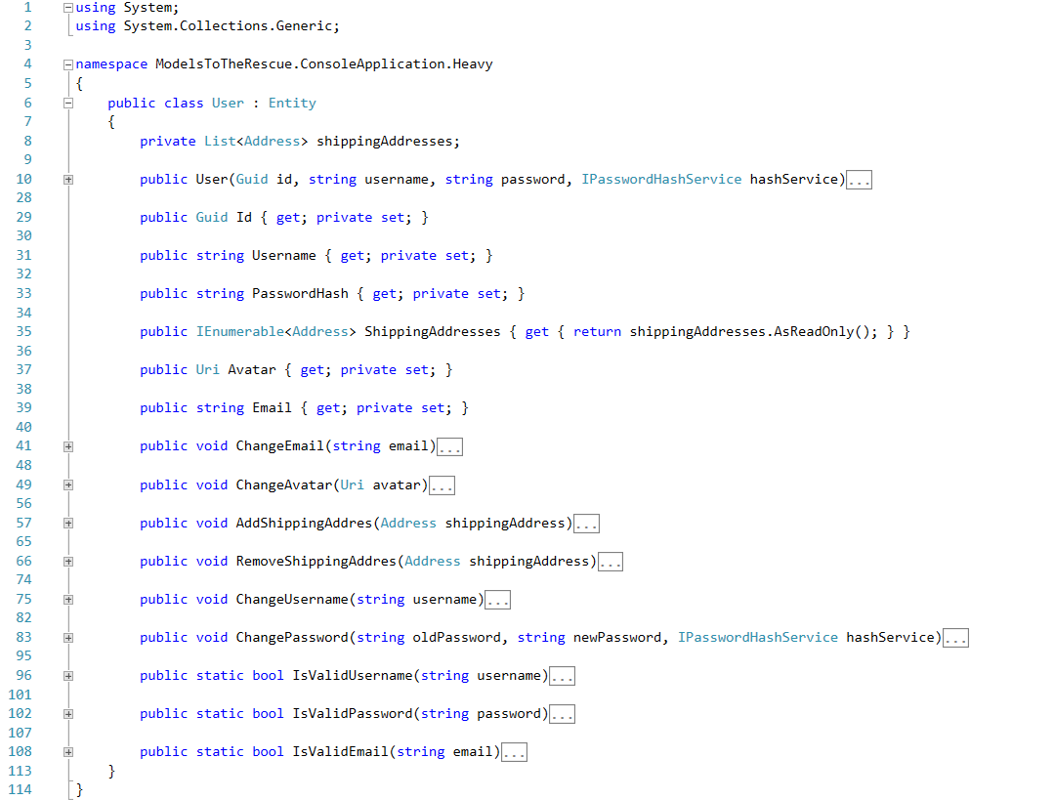
Notes:
And than we add an Email….

Slide 47
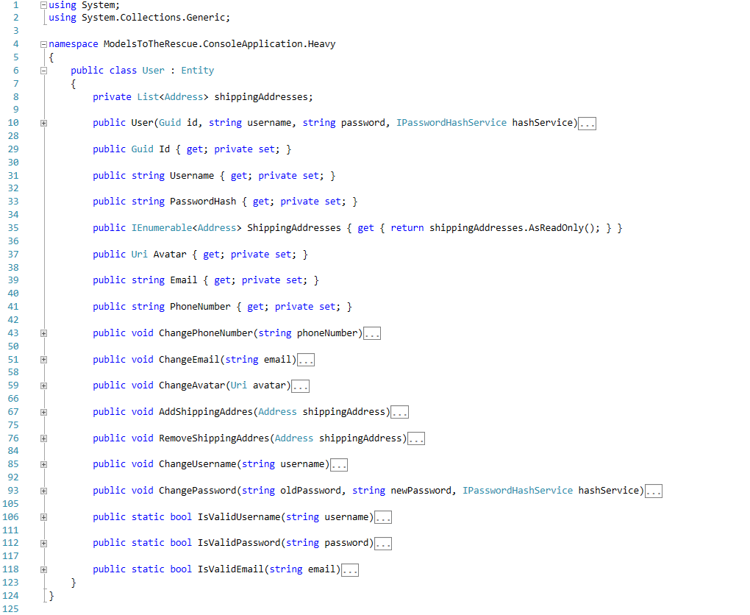
Notes:
And a phone number…
At this point its starting to become unmanageable. The file is 125 lines.
Yes the code itself is all right but the model is having to many responsibilities, SOLID?
If two people are working on two different parts of the system should they change the same files?
We call this a Heavy model… NEXT;

Slide 48
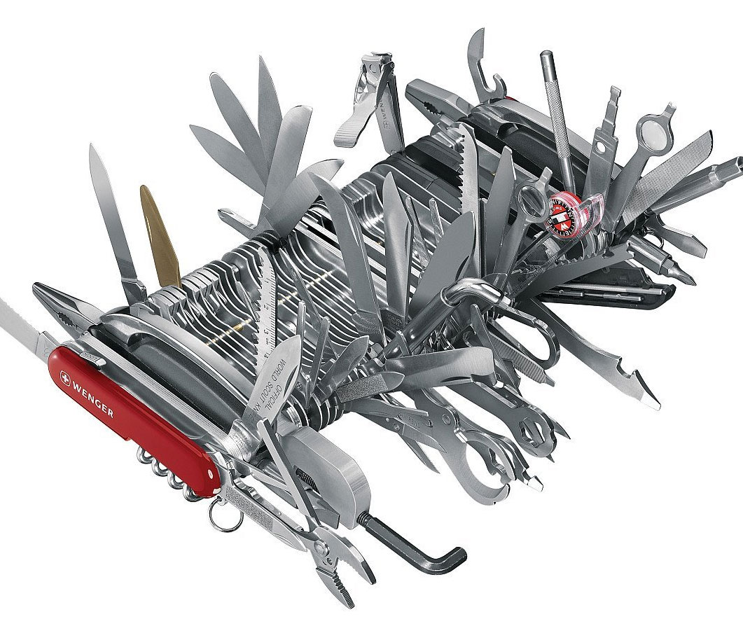
Heavy Model
Notes:
Have so many responsibilities, so that’s its difficult to support. Its expensive to add, remove, or change functionality.

Slide 49
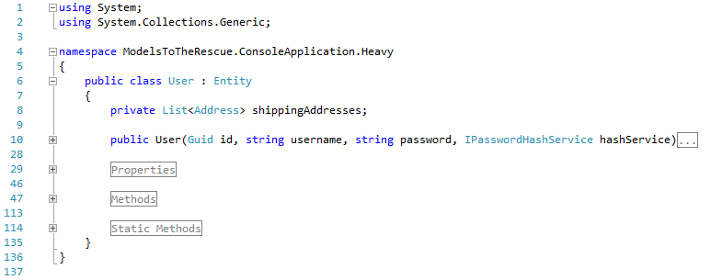
Usually
Notes:
Personally I don’t like regions.
For me it means that the regions needs to be refactored. The class or the method has to many responsibilities.
It decreases readability when used like its shown on the screenshot.
Refactor it..

Slide 50
Lets Refactor

Slide 51
"If the modifications, needed to accommodate new observations, become too baroque, it signals the need for a new model."
- Stephen Hawking & Leonard Mlodinow, The Grand Design

Slide 52
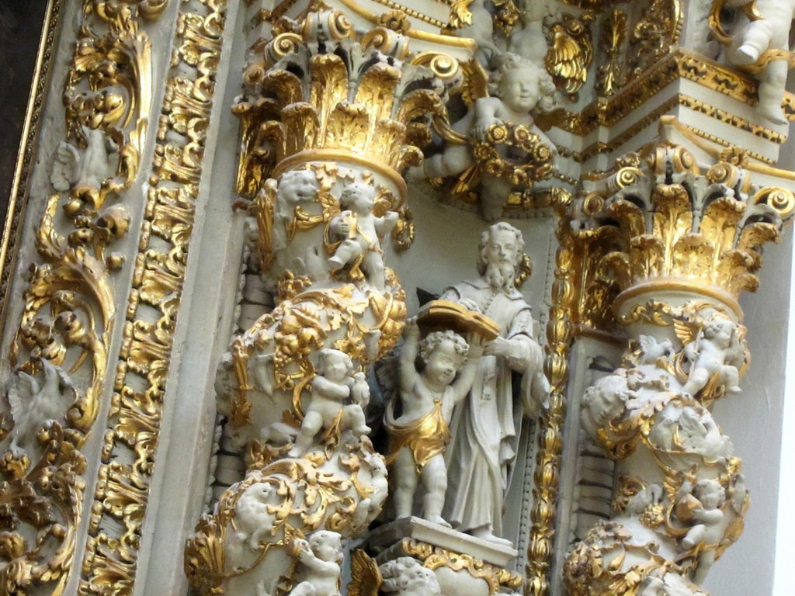

Slide 53
"If the modifications, needed to accommodate new observations, become too baroque or grotesque, it signals the need for a new model."

Slide 54
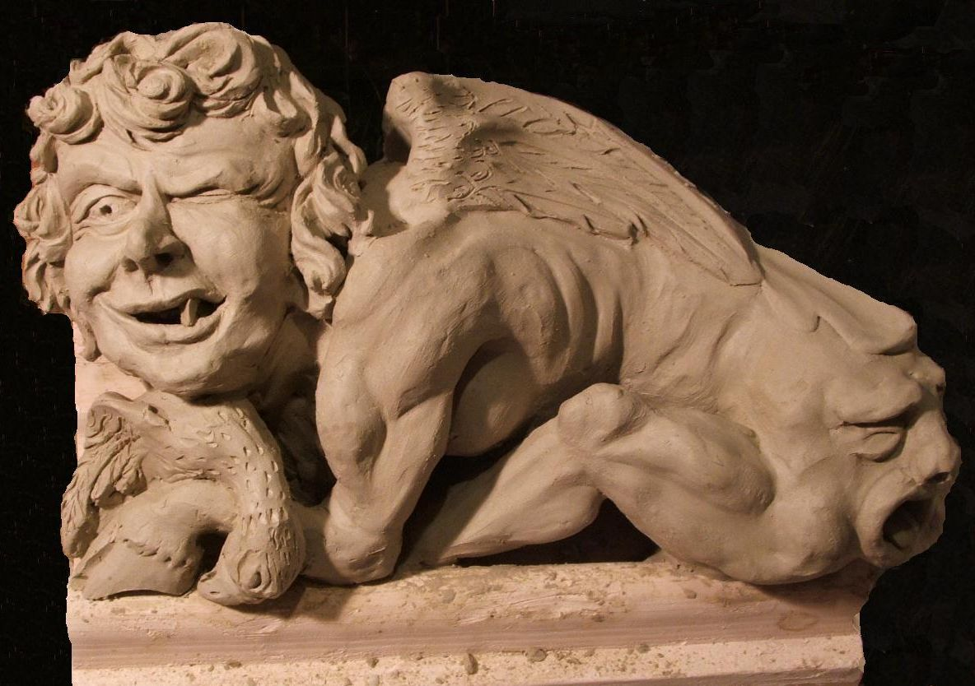

Slide 55
Notes:
Lets move out the address first

Slide 56
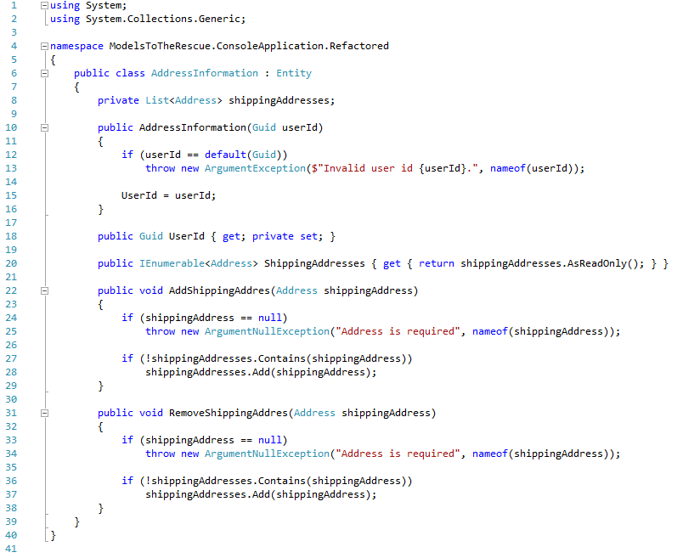
Notes:
Talk on the code
Then the profile information;

Slide 57
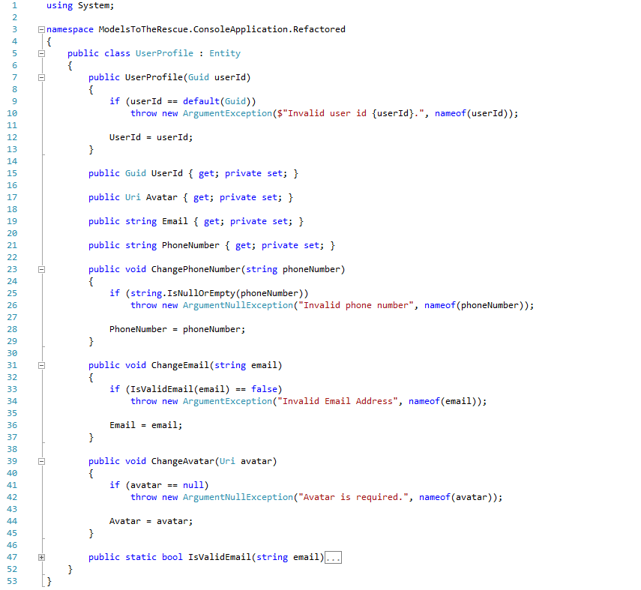
Notes:
Talk on the profile…
And now we have our initial beautiful user

Slide 58
Notes:
Three models belonging of the same thing…

Slide 59
Thanks!
Any questions?

Slide 60
- S.O.L.I.D - Models for the Rescue - Domain Driven Design - DDD Introduction - DDD Strategic Design - DDD Tactical Design - Software Architecture (Parts I, II & III) - Application Lifecycle Management - Continuous Integration, Deployment, Delivery - Generic Domain as a Service - CQRS - Event Sourcing - oAuth 2.0 & OIDC - Lucene - Hystrix - Cassandra
Coming up!
Notes:
Software Architecture
Boundaries,
CAP Theorem
Layered Architecture
Messaging
Microservices
Onion Architecture
Scalability
SOA
Logical Architecture vs Physical Architecture
Publish/Subscribe
Eventual Consistency

